Slide 1
Topic 4 and 5: Synchronous & Asynchronous Sequential Circuit
Counters
Registers

Slide 2
Synchronous Counter design
Asynchronous counter design is very easy as we need to set J=K=T=1 for all the cases and clocks for all the Flip flops are needed to set up when there is a transition required at the output.
But In synchronous counter design, all clock inputs share the same clock. So, we need to set J, K or T =1 condition, when there is a transition required at the output.
So synchronous counter design is a bit tricky but very easy

Slide 3
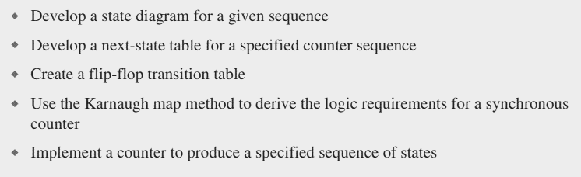
Synchronous Counter design
The following steps are needed to design a synchronous counter:

Slide 4
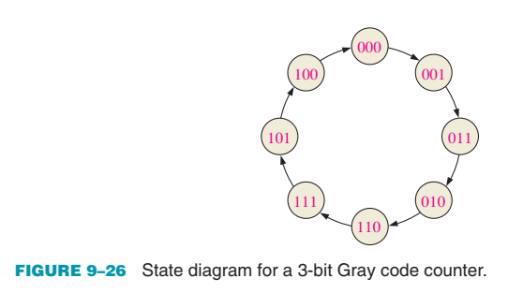
Synchronous Counter design
Lets design a 3 bit gray code counter design
First step is to get the state diagram

Slide 5
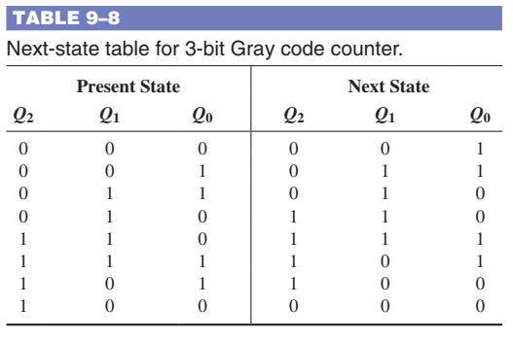
Synchronous Counter design
Second step is to get the next state diagram

Slide 6
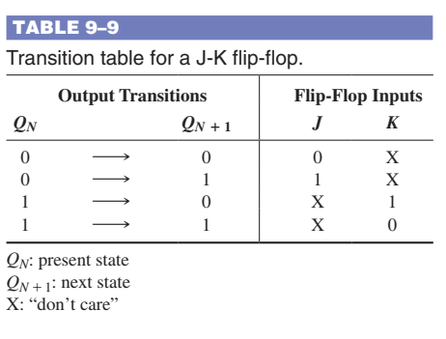
Synchronous Counter design
Third step is to know the FF transition Table for JK or T FF.

Slide 7
Synchronous Counter design
Fourth step is to derive the logic requirements for the counter
Q2 | Q1 | Q0 | J2 | K2 | J1 | K1 | J0 | K0 | T2 | T1 | T0
0 | 0 | 0 | 0 | X | 0 | X | 1 | X | 0 | 0 | 1
0 | 0 | 1 | 0 | X | 1 | X | X | 0 | 0 | 1 | 0
0 | 1 | 1 | 0 | X | X | 0 | X | 1 | 0 | 0 | 1
0 | 1 | 0 | 1 | X | X | 0 | 0 | X | 1 | 0 | 0
1 | 1 | 0 | X | 0 | X | 0 | 1 | X | 0 | 0 | 1
1 | 1 | 1 | X | 0 | X | 1 | X | 0 | 0 | 1 | 0
1 | 0 | 1 | X | 0 | 0 | X | X | 1 | 0 | 0 | 1
1 | 0 | 0 | X | 1 | 0 | X | 0 | X | 1 | 0 | 0
0 | 0 | 0

Slide 8
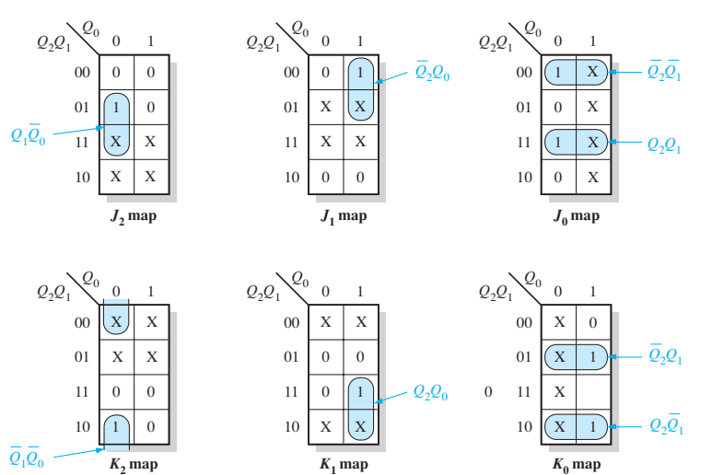
Synchronous Counter design
Fourth step is to derive the logic requirements for the counter

Slide 9
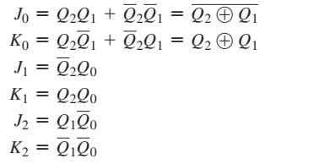
Synchronous Counter design
Fourth step is to derive the logic equations for the counter inputs

Slide 10
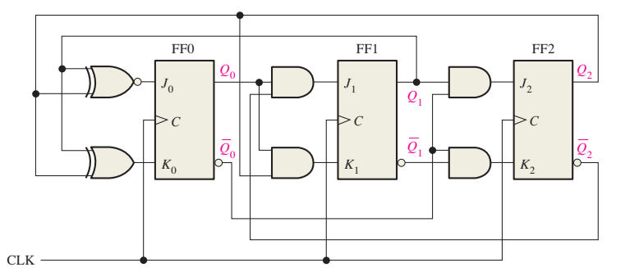
Synchronous Counter design
Fifth step is to design the logic circuit

Slide 11
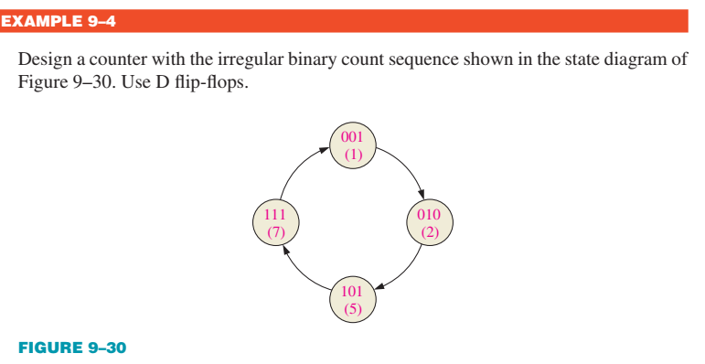
Synchronous Counter design Example

Slide 12
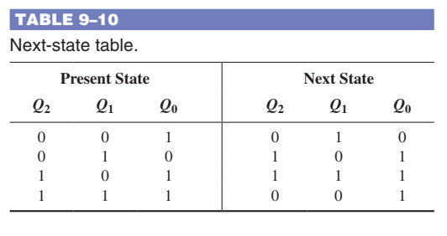
Synchronous Counter design Example

Slide 13
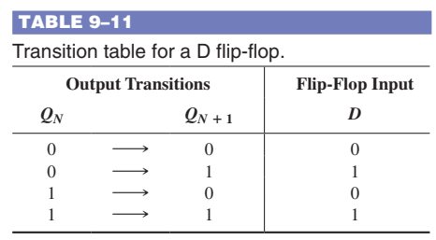
Synchronous Counter design Example
Create your own Table like in slide 7 for all the inputs (D0, D1 and D2) in terms of current outputs (Q0, Q1 and Q2).

Slide 14
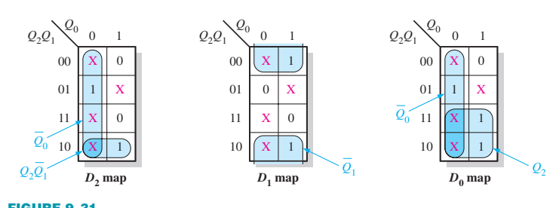
Synchronous Counter design Example
Q2 | Q1 | Q0 | D2 | D1 | D0
0 | 0 | 1 | 0 | 1 | 0
0 | 1 | 0 | 1 | 0 | 1
1 | 0 | 1 | 1 | 1 | 1
1 | 1 | 1 | 0 | 0 | 1
0 | 0 | 1

Slide 15
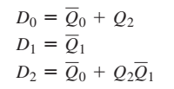
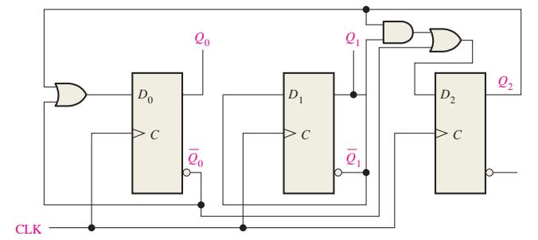
Synchronous Counter design Example

Slide 16

Any Questions

